Slide 1
loT Based Safety Gadget for Child Safety Monitoring and Notification
Team ID : PNT2022TMID10533

Slide 2
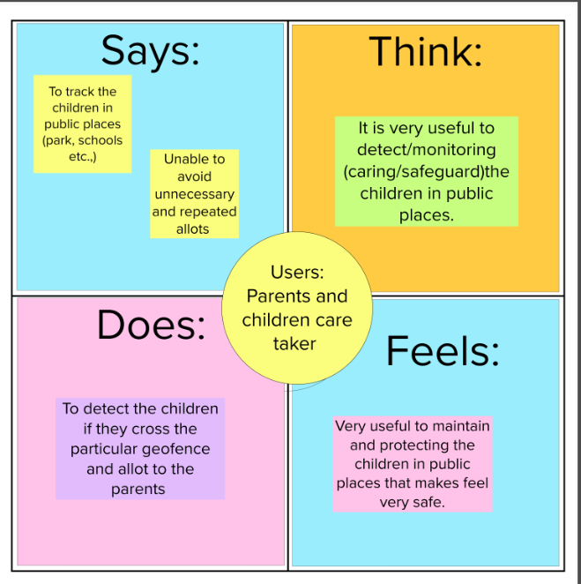
Team ID : PNT2022TMID10533

